Slide 1
CVCoach
Your best CV assistant
Lecturers: Team 5

Slide 2
Overview
What we’ve done
How we test
(Video) Demo
Plan for next iteration

Slide 3
What we’ve done
Login
Resume analysis with job description
Integration Testing, System Testing

Slide 4
Login - User story
As a user, I want to log in using my Google account so that I can track my historical analysis records.
Acceptance Test:
Given this is my first time using this website
When I click the ‘Login’ button
Then I will be able to log in using my Google account and track my historical conversations.

Slide 5
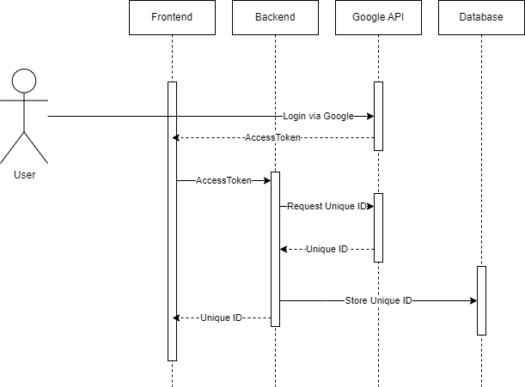
Login - Sequence diagram

Slide 6
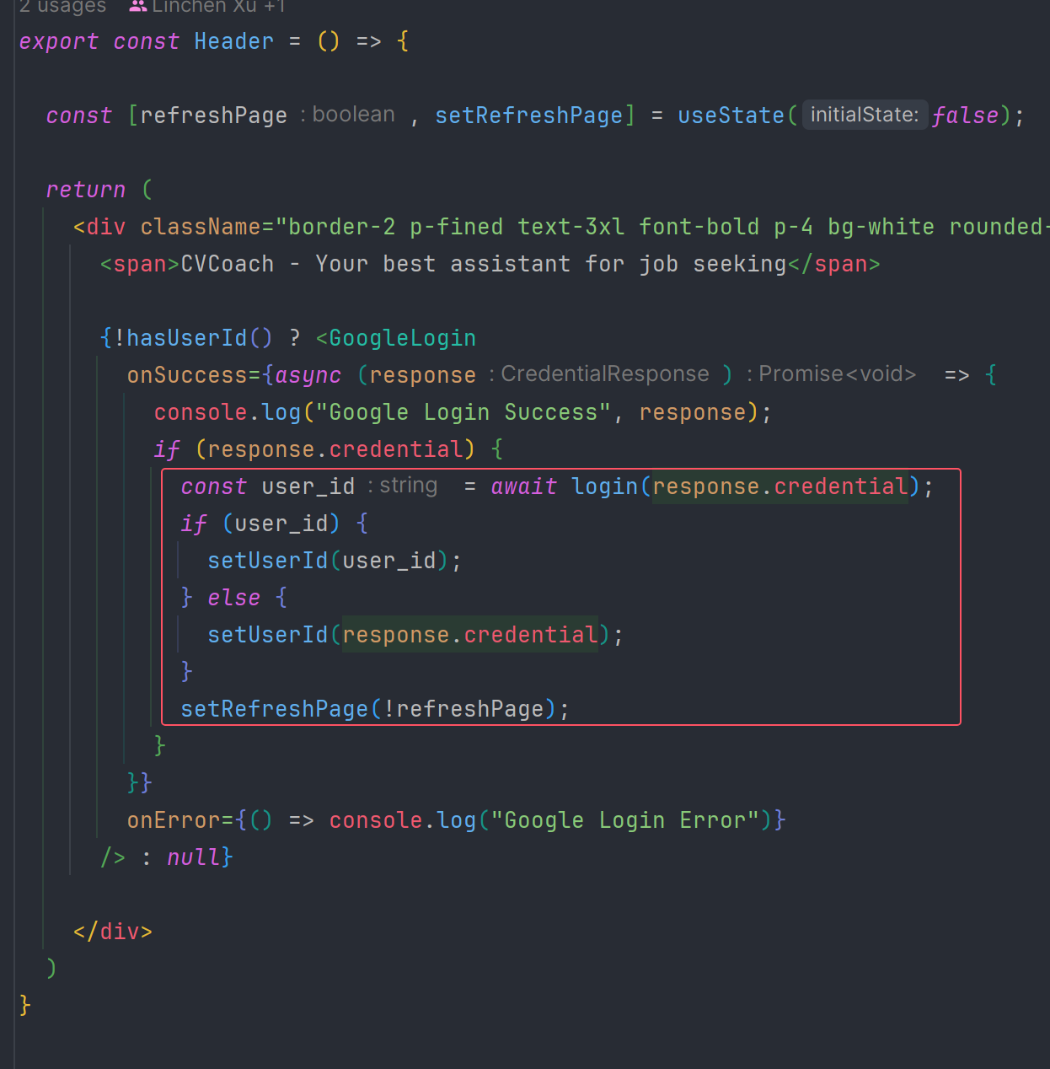
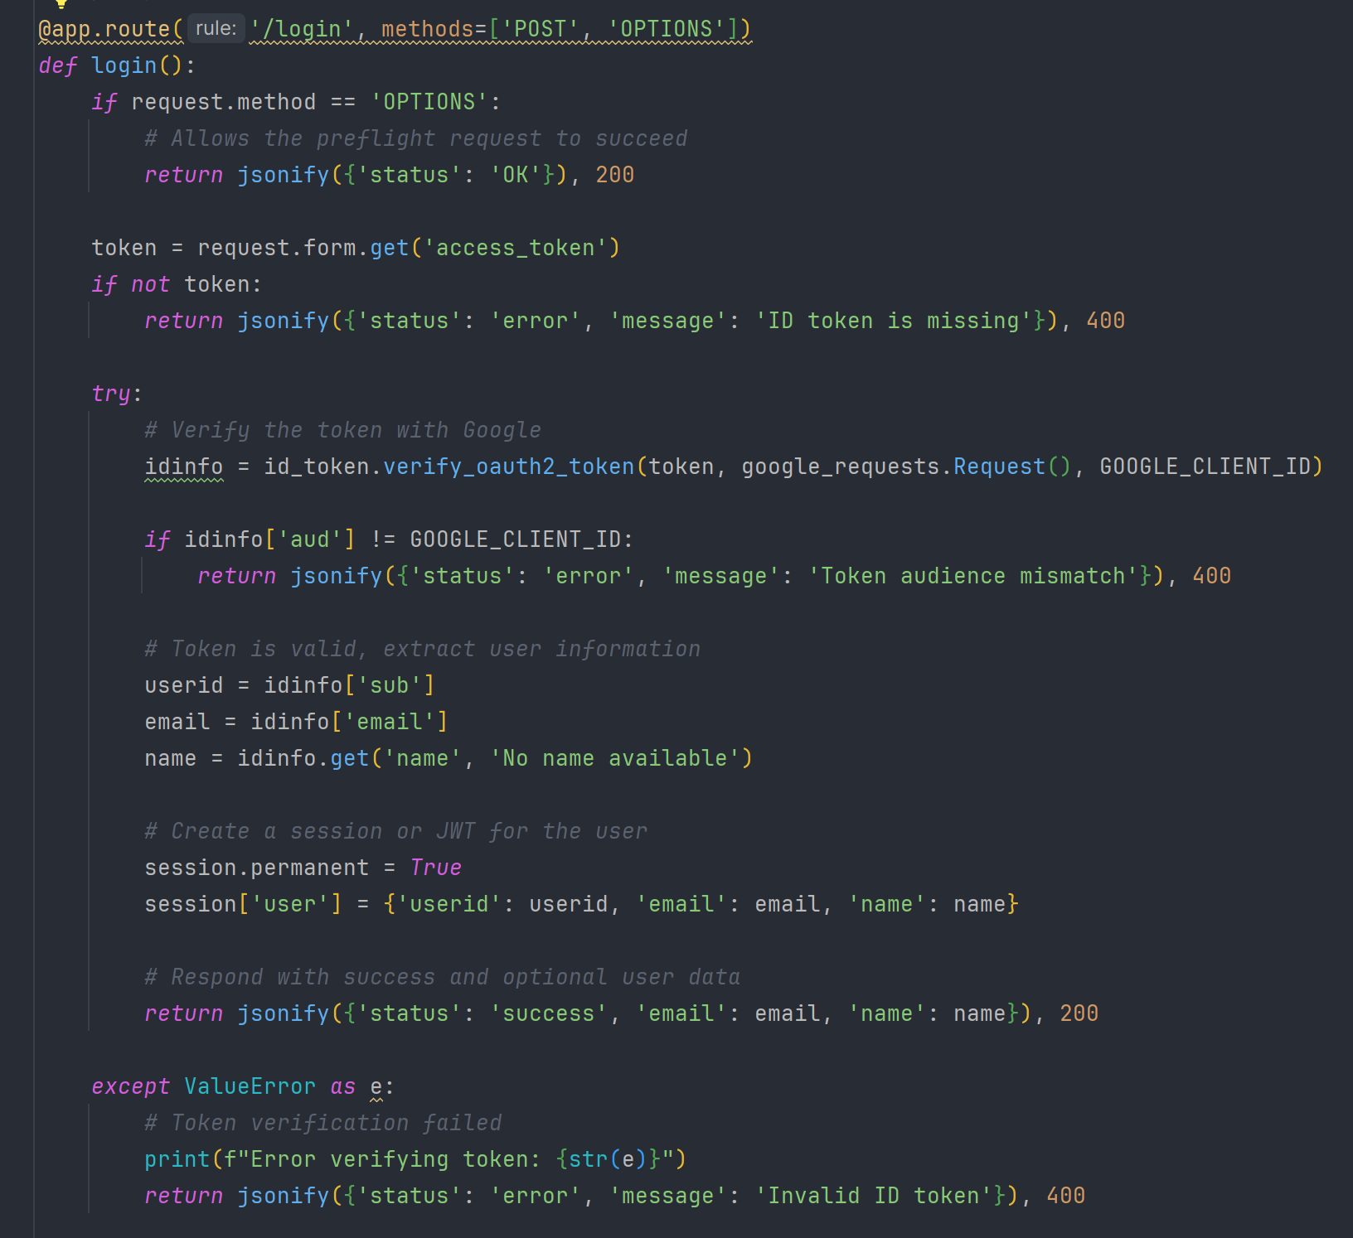
Login - Implementation

Slide 7
Resume analysis - User story
As a job seeker, I want to upload my resume so that I can receive feedback on how well I match a specific job description and increase my chances of getting the job.
Acceptance Test:
Given I want to analyze my resume
When I start the conversation
Then I will be asked to upload my resume and job descriptions. After that, I can click the ‘Analyze’ button to start an analysis.

Slide 8
Resume analysis - Algorithm
Criteria:
1. Education
2. Project and Work Experience
3. Skills and Certifications
4. Soft Skills
5. Resume Structure and Presentation
6. Consistency and Chronology

Slide 9
Correlate resume with job description
Extract the keywords from resume and job description
Calculate correlation coefficient of the keywords in resume and job description
Result ranges from 0 to 1, where 0 means there is no correlation while 1 means there is a perfect correlation between these two variables.

Slide 10
Score calculation formula
Score = relevance of job description * xx% * CC + achievements * xx% * CC + education and certification * xx% ** CC + resume structure and presentation * xx% * CC + soft skills * xx% * CC + consistency and chronology * xx% * CC. (CC stands for correlation coefficient)
This score indicates how well the candidate’s resume fits the given job description

Slide 11
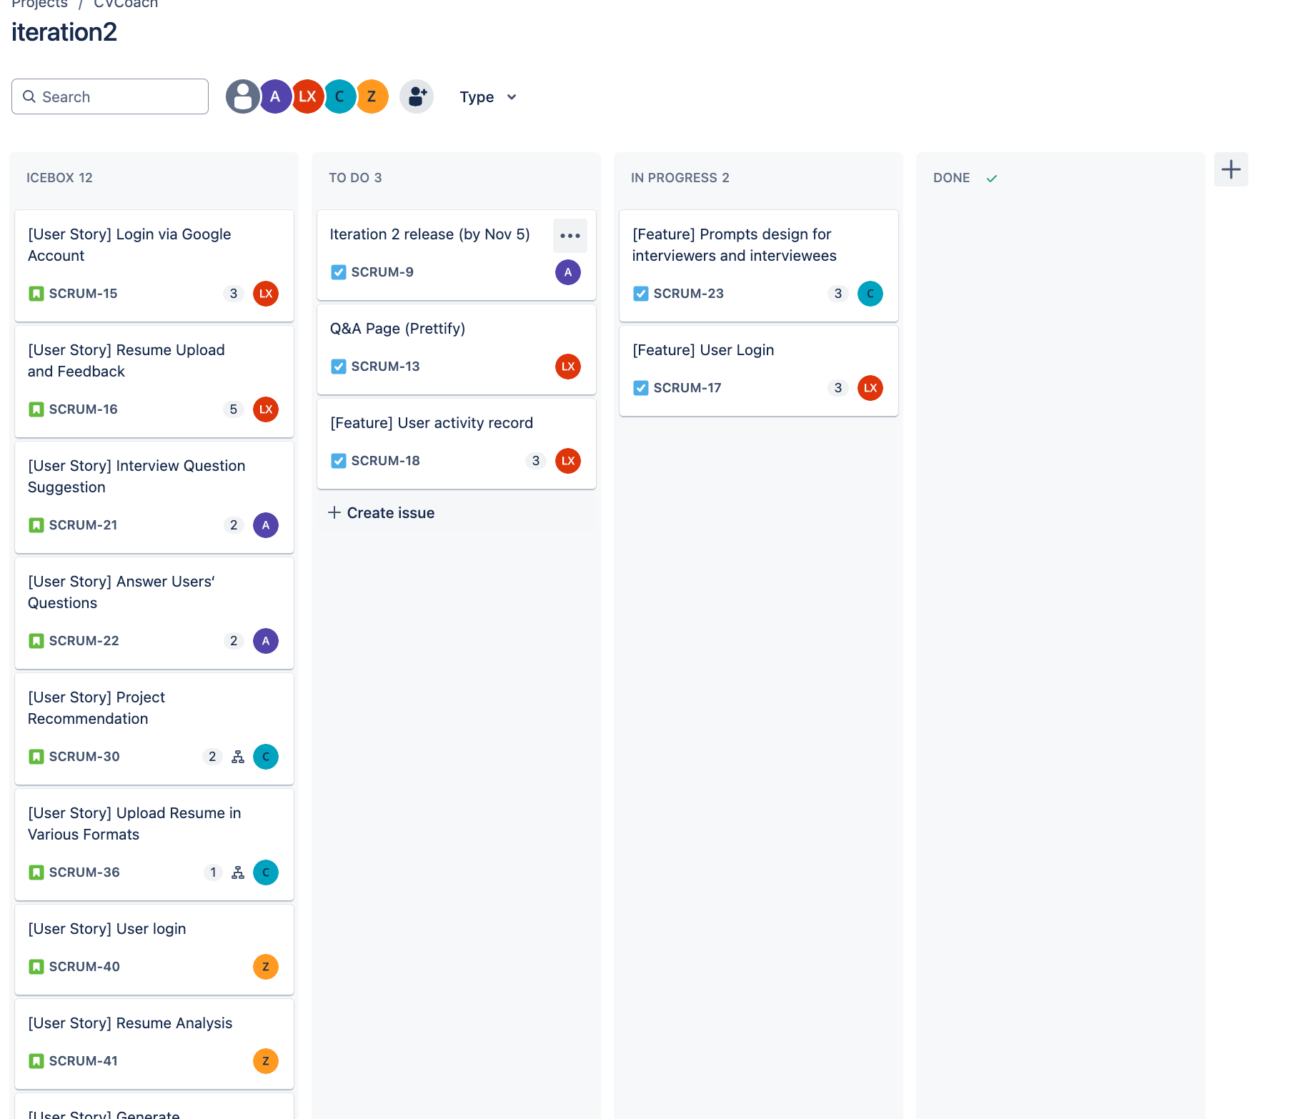
Jira
3 TODOs
2 Inprogress

Slide 12
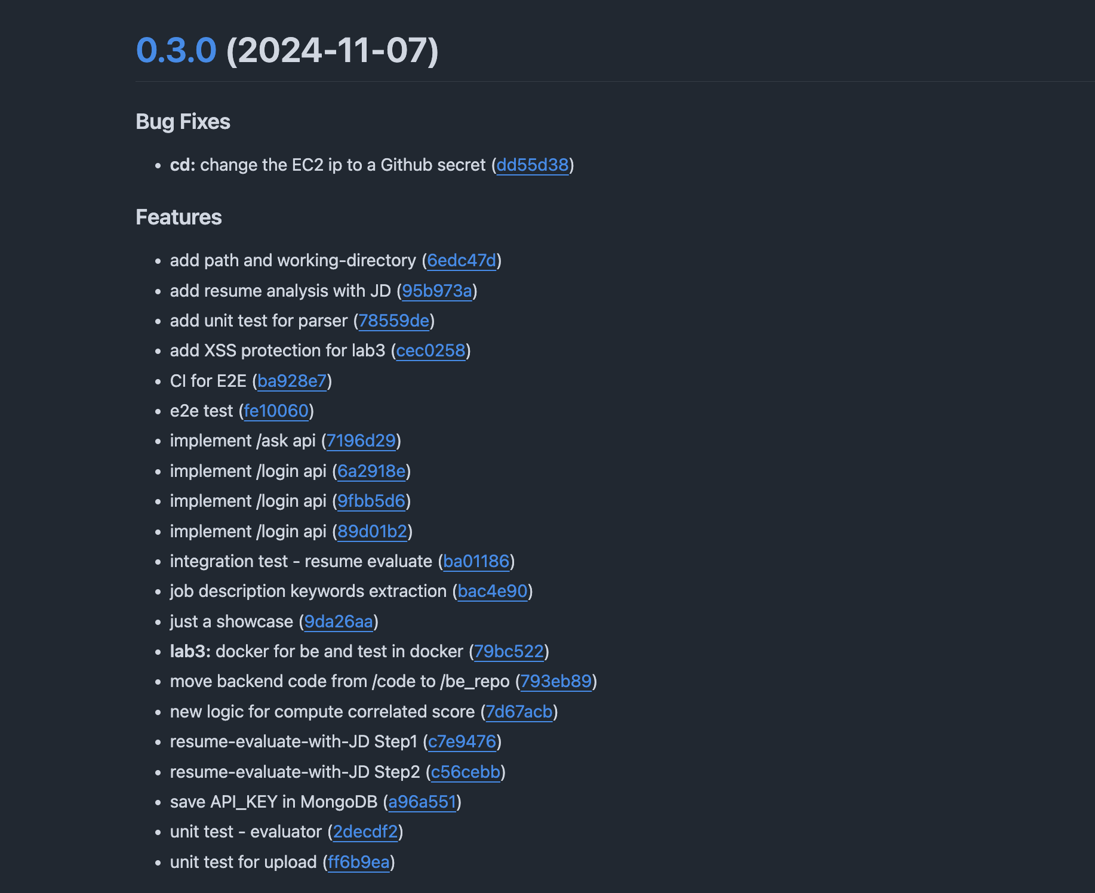
Commits
1 Bug Fixes
21 Features

Slide 13
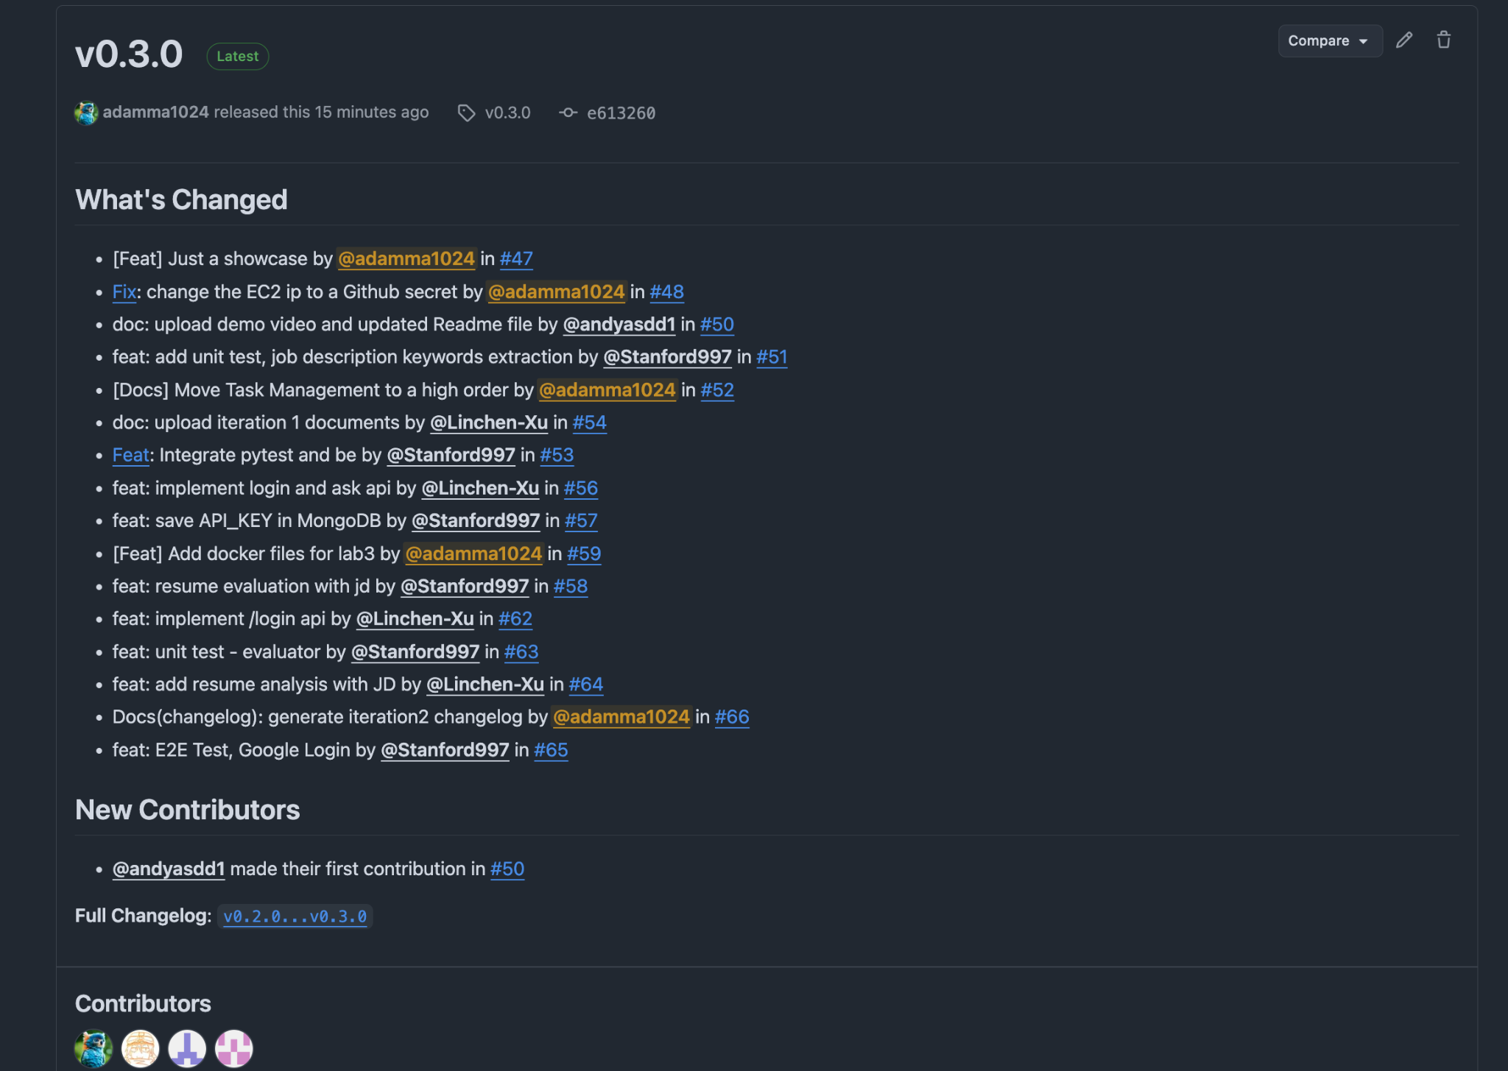
PRs
16 PRs

Slide 14
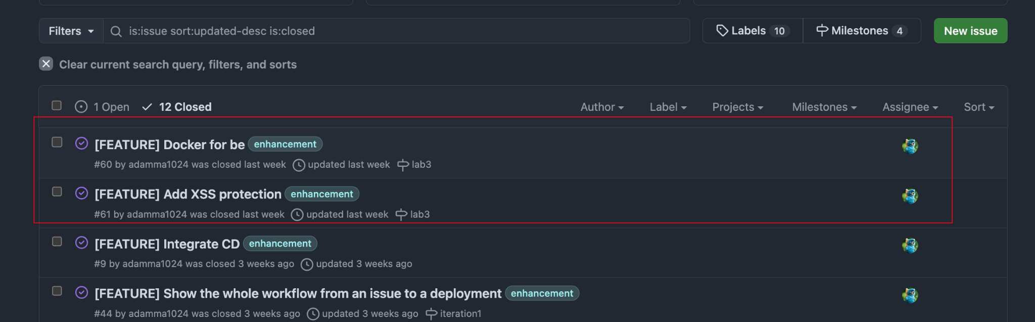
Issues
Closed 2 Issues

Slide 15
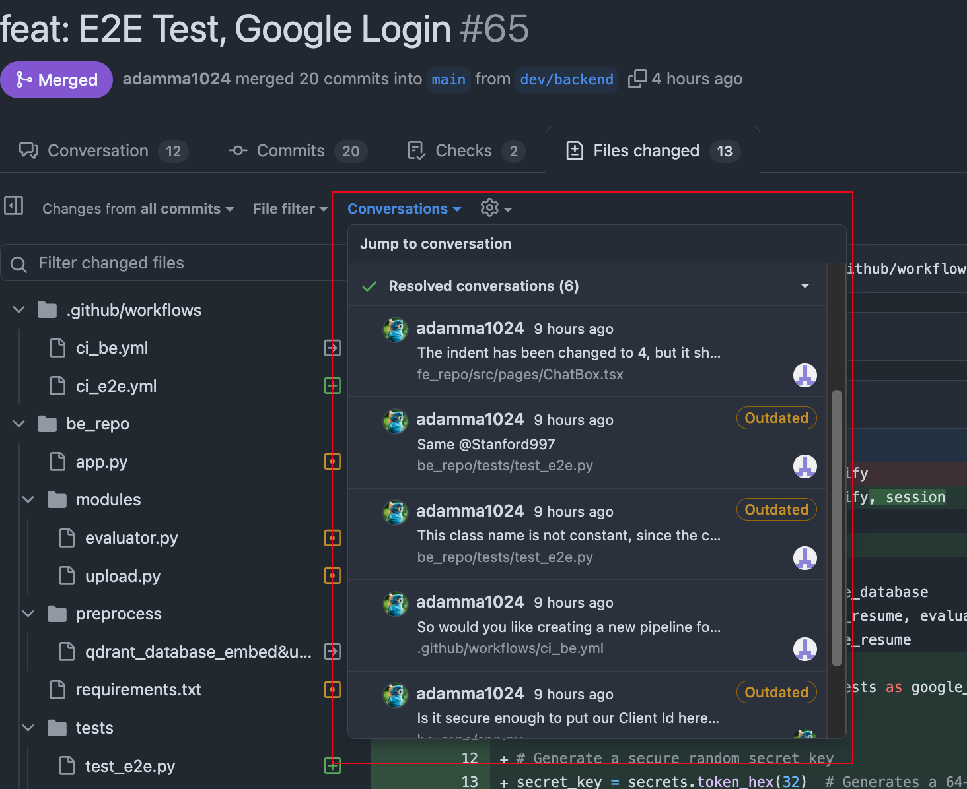
Code Review
For each PR, there is at least one reviewer to review.
And the comments are blockers avoiding checking in bad smell codes.

Slide 16
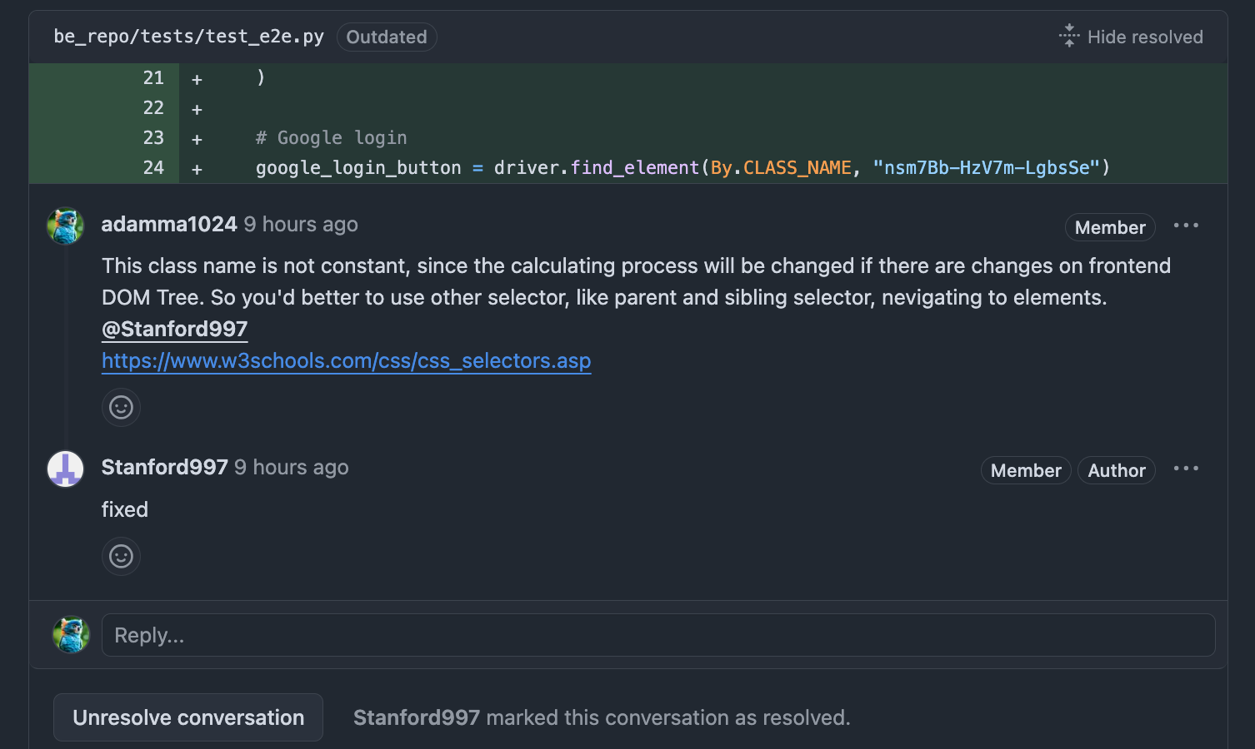
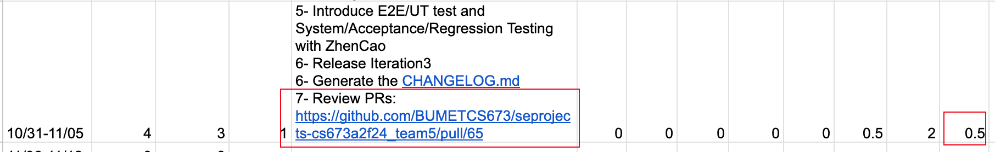
Demo link
Appreciate to the person who takes time to review your codes.

Slide 17
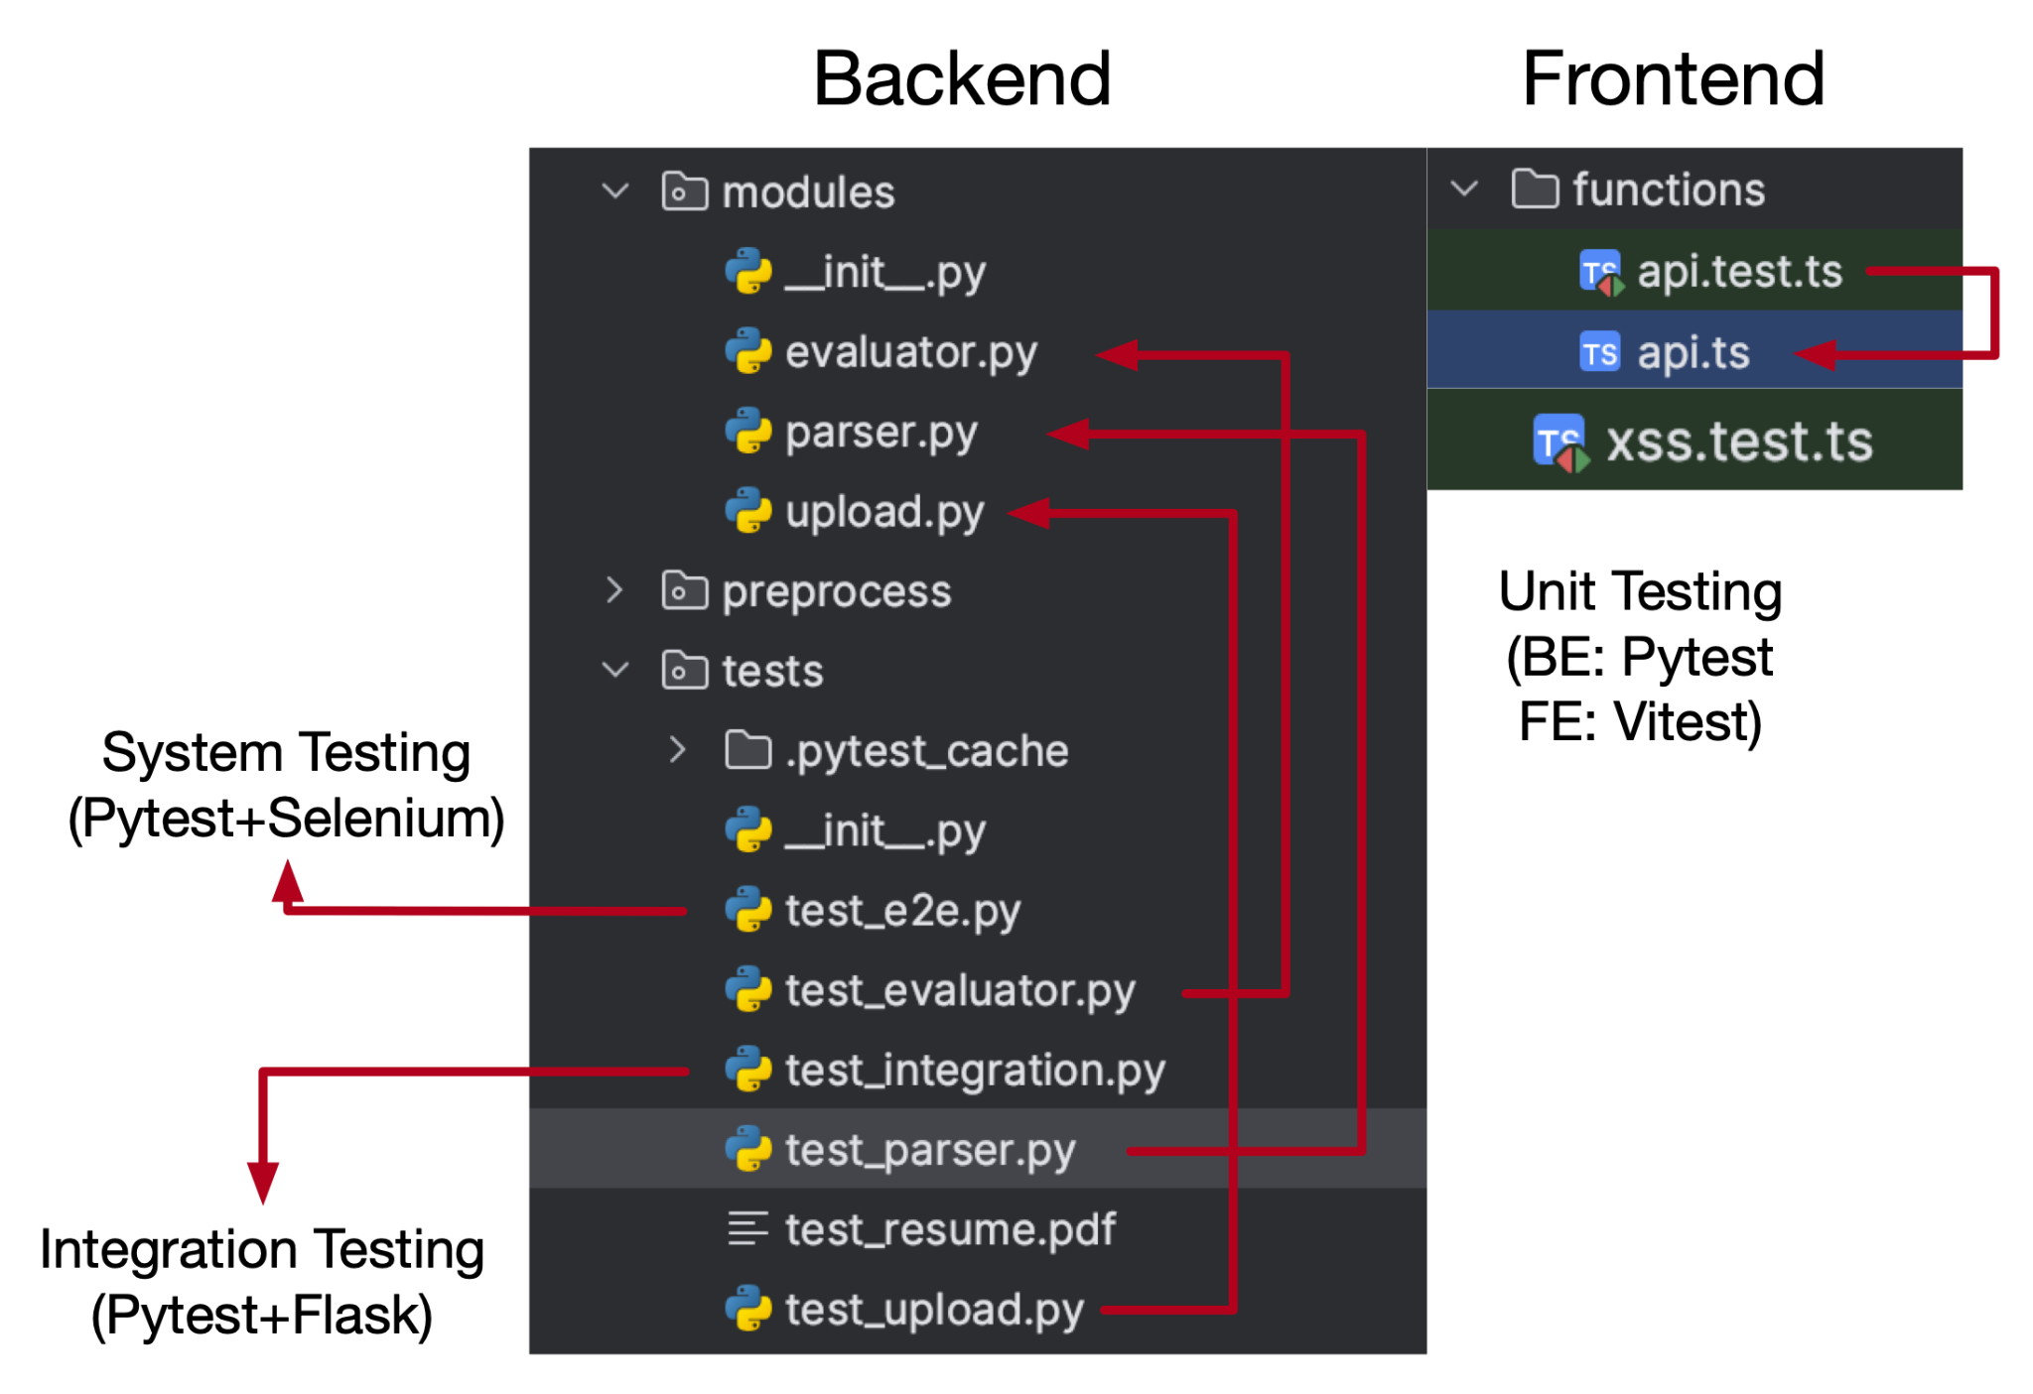
How we test
Unit Testing
Integration testing
System Testing
Regression Testing
Acceptance Testing

Slide 18
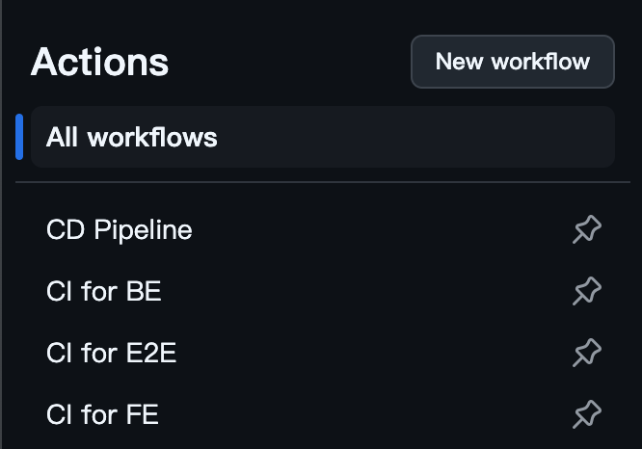
Automated Testing
Unit Testing
Integration testing
System Testing
Regression Testing
ng

Slide 19
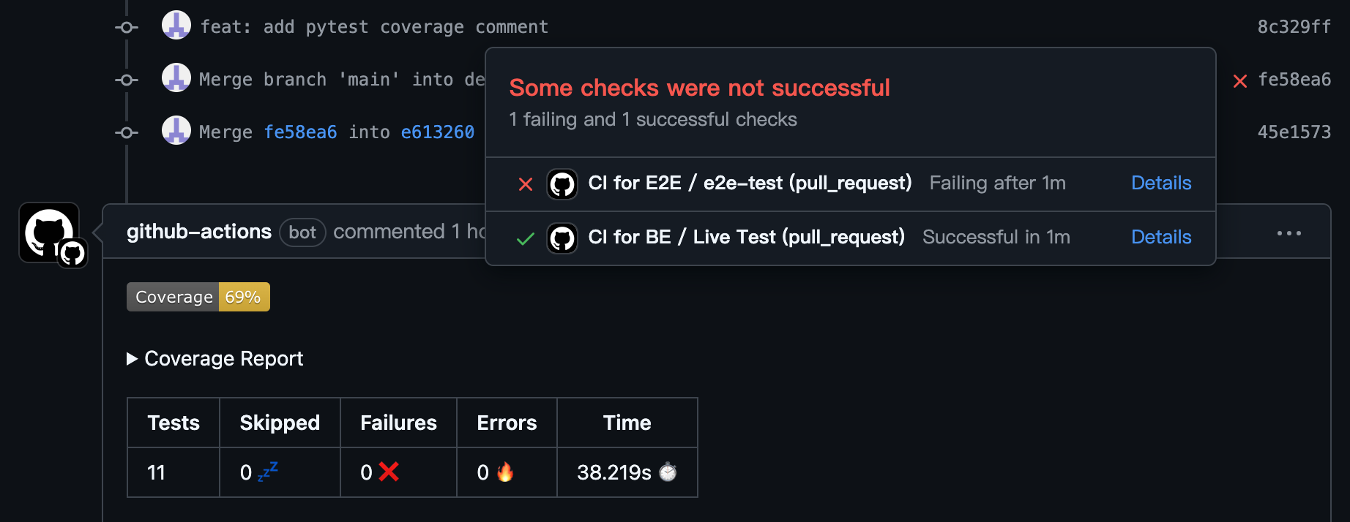
Pytest Coverage Comment

Slide 20
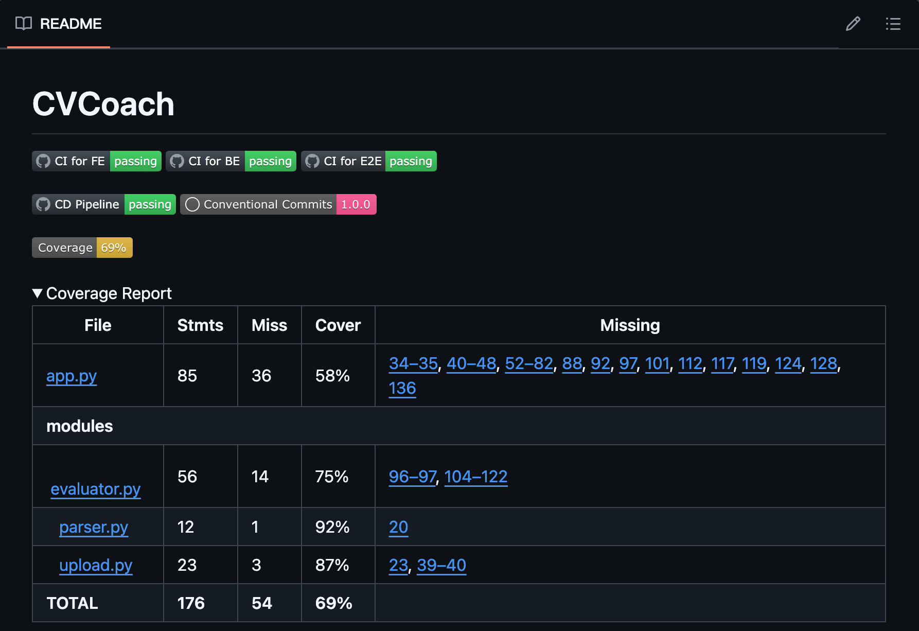
Auto Updating Badge and Report on README

Slide 21
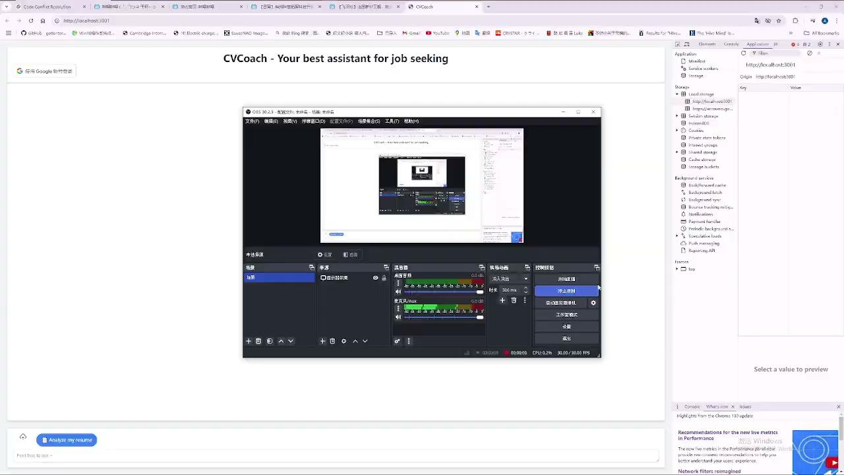
Demo

Slide 22
Plan for next iteration
Interview question suggestion
Answer user’s questions

